Slide 1
Post-Implementation Evaluations of G20 Financial Regulatory Reforms
Challenges & Opportunities
Neeltje van Horen
Bank of England & CEPR
2018 CEBRA Annual Meeting -Plenary Session II
Frankfurt, 20-21 August 2018
Disclaimer: This presentation represents my own views and not necessarily those of the Bank of England or its staff.

Slide 2
Three key challenges policy evaluation
Benchmarking:
“Evaluate by comparison with a standard”
Feasibility:
“Capacity to carry out a meaningful evaluation”
Objectivity:
“Ensure no bias, judgement or prejudice affects the outcome”

Slide 3
Benchmarking
Identifying market failure, risk or problem
Developing and implementing policy
Policy evaluation
Ex ante cost-benefit analysis essential
Expected impact on particular market
Identify unintended consequences

Slide 4
Feasibility
Technical skills
Data
Resources

Slide 5
Feasibility: Technical skills
Ability to deal with methodological challenges
Recognize useful policy shocks to exploit
Address endogeneity concerns to enable causal inference
Reverse causality
Omitted variables
Knowledge state-of-the-art techniques

Slide 6
Feasibility: Technical skills
Ability to understand the policy
Ex ante cost-benefit analysis
What were the expected outcomes?
Any unforeseen/unintended consequences?
How was policy implemented
Which banks affected?
How exactly affects banks’ balance sheet?

Slide 7
Feasibility: Data
Detailed data extremely important
Counterfactual: before and after regulatory reform
Endogeneity
Demand vs supply
Confounding factors
Heterogeneous effects
Small vs large
Banks vs non-banks

Slide 8
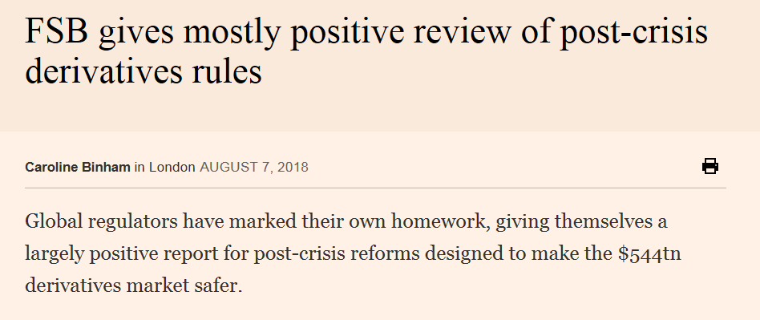
Objectivity
Financial Times on FSB Evaluation of Central Clearing of OTC Derivatives

Slide 9
Objectivity
Having a framework that is applied consistently
Building trust of public
Complemented with independent research
Validation through peer review

Slide 10
Important role for Central Bank researchers
Methodological skills
Direct access to policy makers
Access to supervisory data
Validation through peer review

Slide 11
Example evaluation G20 regulatory reform
Repo market functioning: The role of capital regulation
Antonis Kotidis and Neeltje van Horen

Slide 12
Why do we care about the repo market?
Facilitates flow of cash and securities
Efficient allocation of capital to real economy
Very large: $12 trillion outstanding
Essential for financial stability and efficient transmission monetary policy

Slide 13
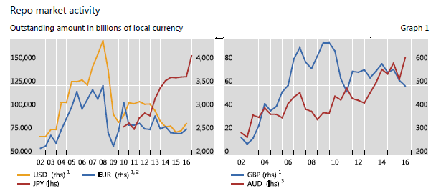
Reduction in repo activity
Source: CGFS report on Repo market functioning

Slide 14

Leverage ratio and repo market
Leverage ratio
Repo market
Capital/balance sheet
Low margin activity
Capital charge same regardless risk/return asset
Counts towards balance sheet
Relative more costly

Slide 15
Benchmarking
Ex ante cost – benefit analysis crucial
Was there intention to reduce repo market liquidity?
Intended or unintended consequence?
Expected heterogeneous effects?
Different segments of the market?

Slide 16
Feasibility
Identification challenges
Plausible exogenous variation affecting some key players
Isolate demand from supply
Control for confounding factors

Slide 17
Feasibility
Policy shock: quasi-natural experiment
Very detailed supervisory data
Technical skills
Access to policy makers to understand implementation policy

Slide 18
Quasi – natural experiment:
Change in reporting requirements UK
January 2016: Introduction 3% leverage ratio
7 stress-tested banks
January 2017: “monthly averaging” to “daily averaging”
Reduces ability to window dress
Tightens leverage ratio
Affected 4 dealers in repo market, 12 unaffected

Slide 19
Affected dealers reacted to this shock

Slide 20
Affected dealers reacted to this shock

Slide 21
Non-affected dealers did not

Slide 22
Key advantages policy shock
Natural control and treatment group
Isolated change
Limited anticipation effects
All affected dealers incentive to react
Exploit exogenous tightening of leverage ratio

Slide 23
Sterling Money Market Database (SMMD)
Supervisory, transaction-level data
Near-universe gilt repo transactions, from Feb 2016
Size, rate, maturity, collateral etc.
Key feature: Dealer and counterparty known
Isolate demand from supply (client fixed effects)

Slide 24
Difference-in-Differences
Change LR Reporting :
January 01, 2017
Month before policy change
Month after policy change
Affected Dealer i
Affected Dealer i
Client j
Client j
Non-Affected Dealer i
Non-Affected Dealer i
∆Volume

Slide 25
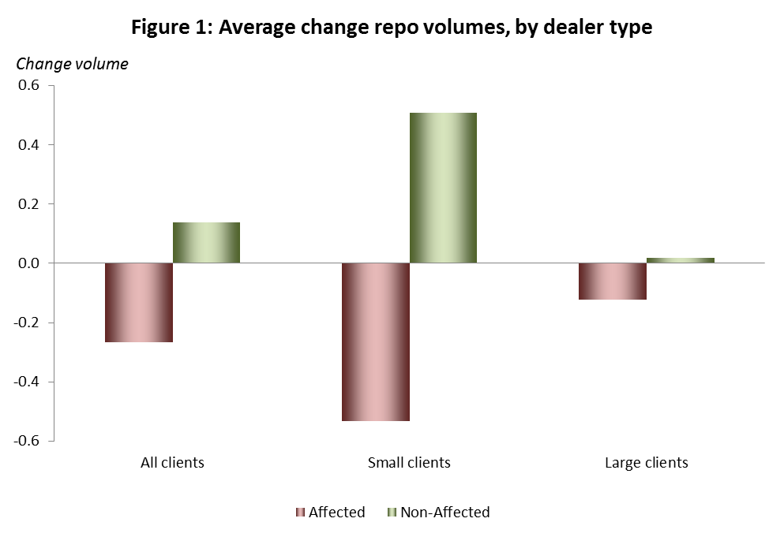
Impact leverage ratio on repo market

Slide 26
Impact leverage ratio on repo market
Reduction repo volume

Slide 27
Impact leverage ratio on repo market
Heterogeneous effects: small clients affected

Slide 28
Impact leverage ratio on repo market
Large clients not

Slide 29
Other margins
Reduction number of transactions
Worsening repo pricing
No impact haircuts or maturities
Consistent with a supply shock due to higher cost repo because tightening of leverage ratio

Slide 30
Aggregate effect
Affected dealers step away from small clients
Assume no change in behaviour non-affected dealers
Small clients can place 32% (2.9 billion) less cash
But non-constrained, foreign dealers stepping in
No 1-on-1 decline total repo activity small clients
Increase market share small clients 39% to 49%

Slide 31
Impact leverage ratio on repo
Tightening leverage ratio reduces repo market liquidity
Especially affecting small clients
Normal conditions: market resilient and quick adjustment
Increase reliance on less stable funding sources (?)

Slide 32
Objectivity
Objective analysis of one consequence leverage ratio
Merits analysis judged by the academic community
Not regulators marking their own homework
But regulators important correct interpretation

Slide 33
Limitations
Partial analysis
Same impact other repo markets?
Interactions with other types of regulation?
No assessment of (social) cost and benefits

Slide 34
Final remarks
Evaluation of regulatory reforms is critical
Feasibility and objectivity are crucial
Key area for interaction policy makers and researchers
Central Bank researchers especially well positioned

Slide 35
THANK YOU

